Slide 1

Intro to NN and Deep Learning
*Some of the slides/diagrams adopted from CMU deep learning course and other CU Boulder resources.

Slide 2
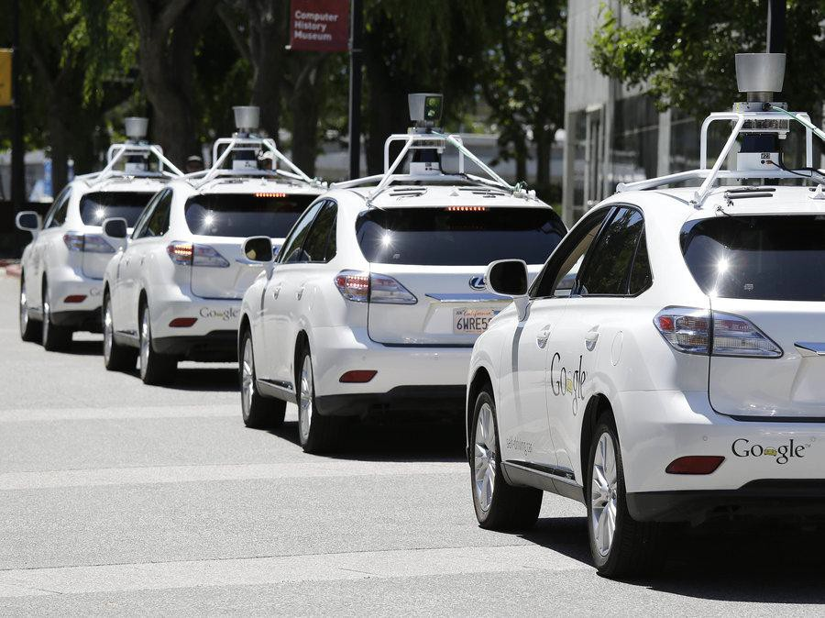
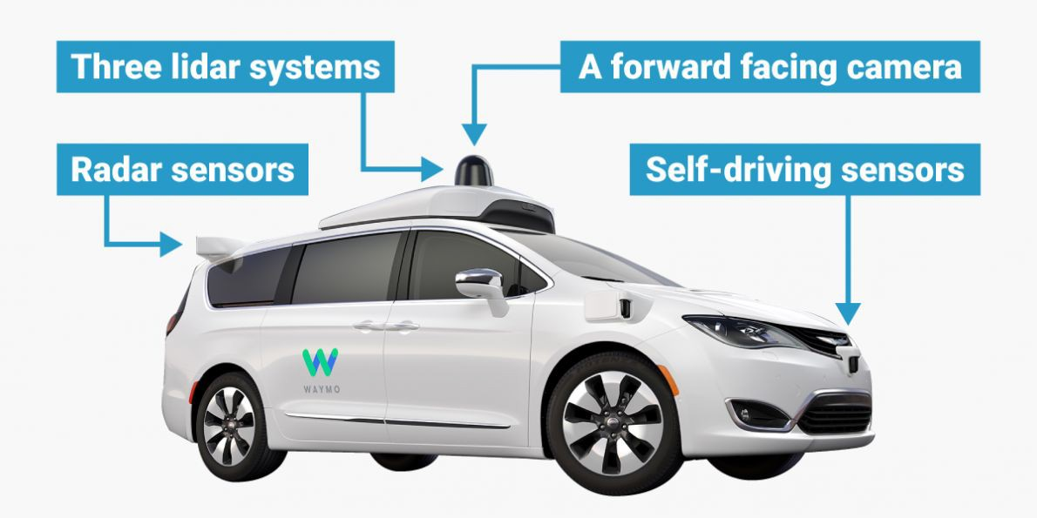
Why Deep Learning?
Self-driving Cars

Slide 3
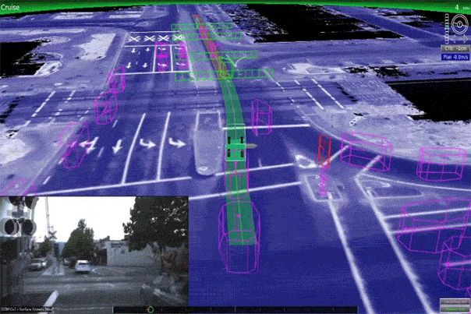
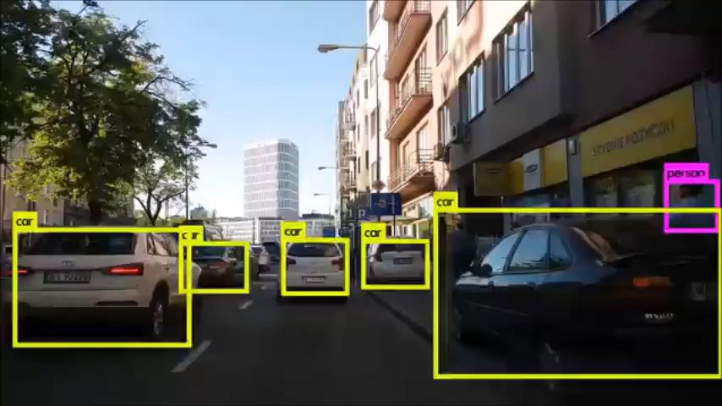
Why Deep Learning?
https://www.youtube.com/watch?v=EhcpGpFHCrw

Slide 4
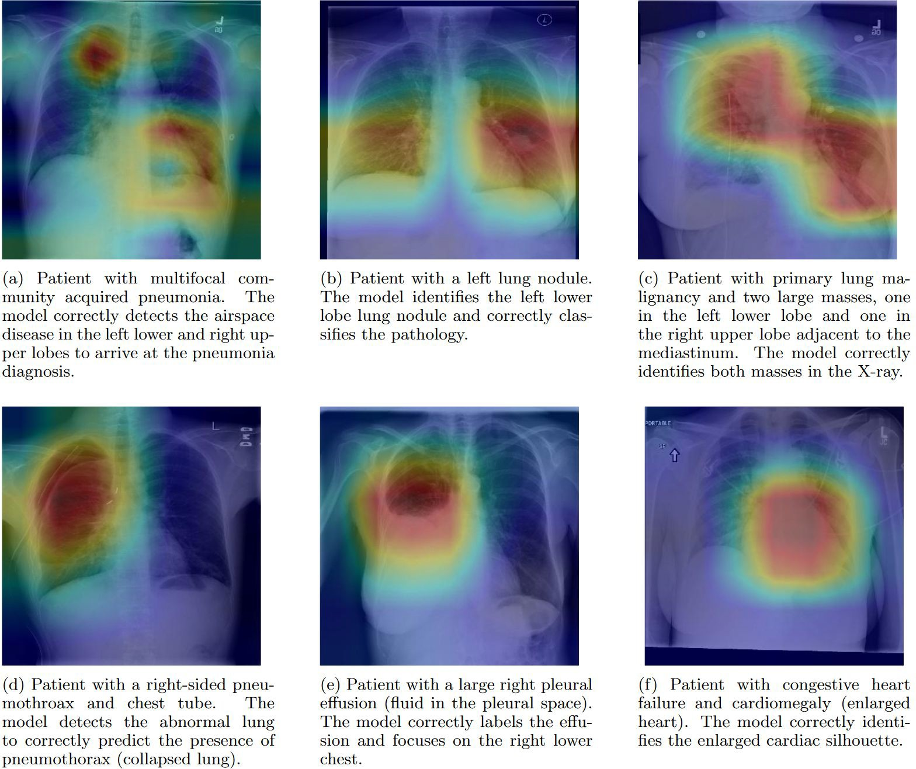
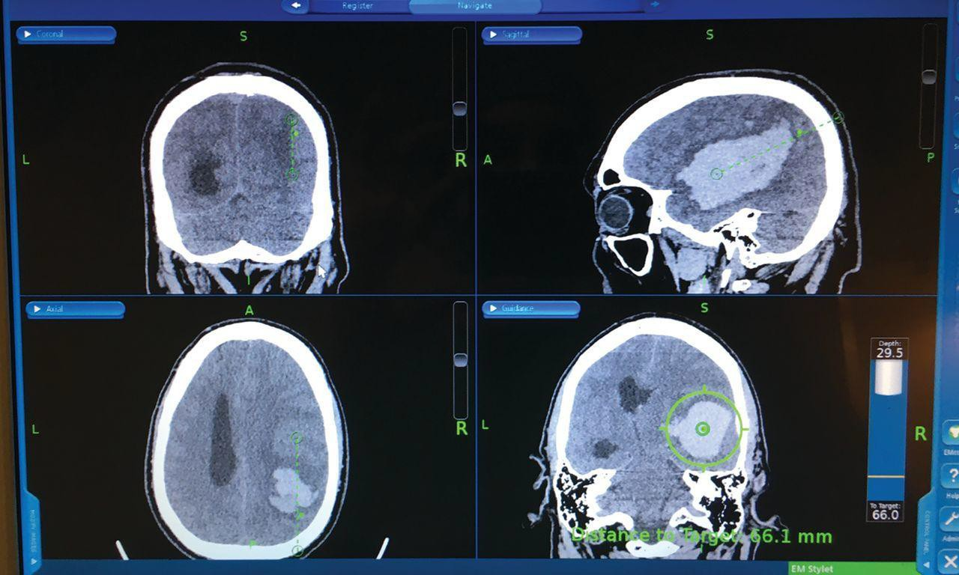
Why Deep Learning?
Medical Imaging, AI in Medicine
P. Rajpurkar et el.,

Slide 5

Why Deep Learning?
Shopping,
e-commerce

Slide 6
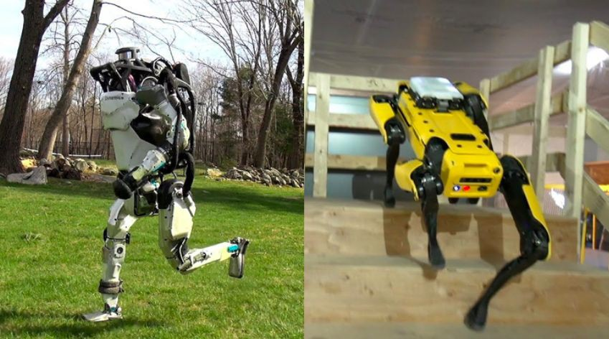
Computer vision in Robotics

Slide 7
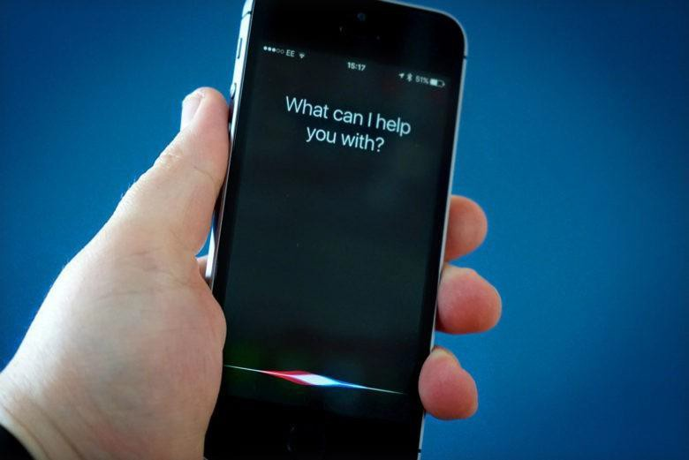
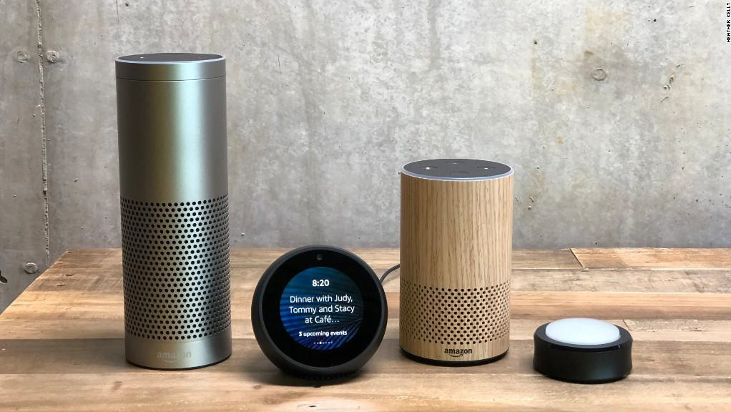
Why Deep Learning?
Voice Recognition,
Smart Devices

Slide 8
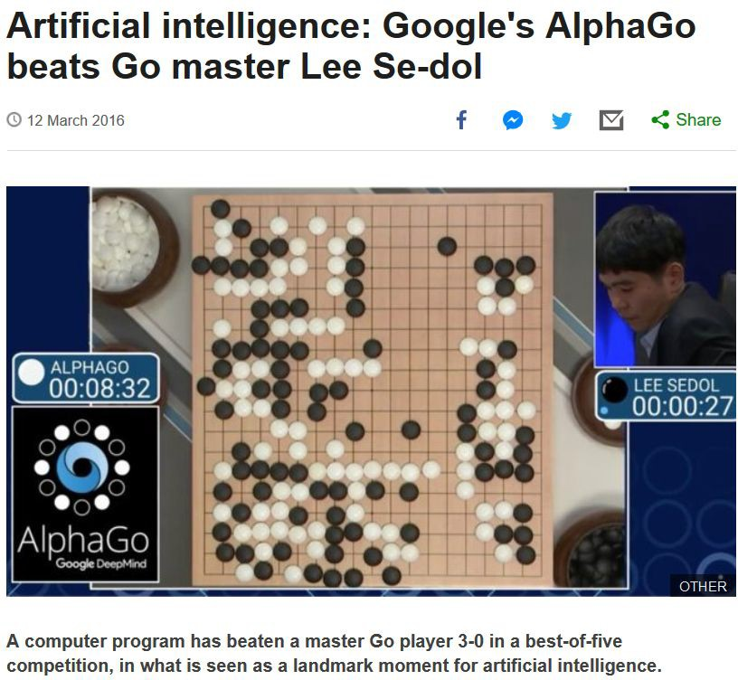
Deep learning in game playing

Slide 9
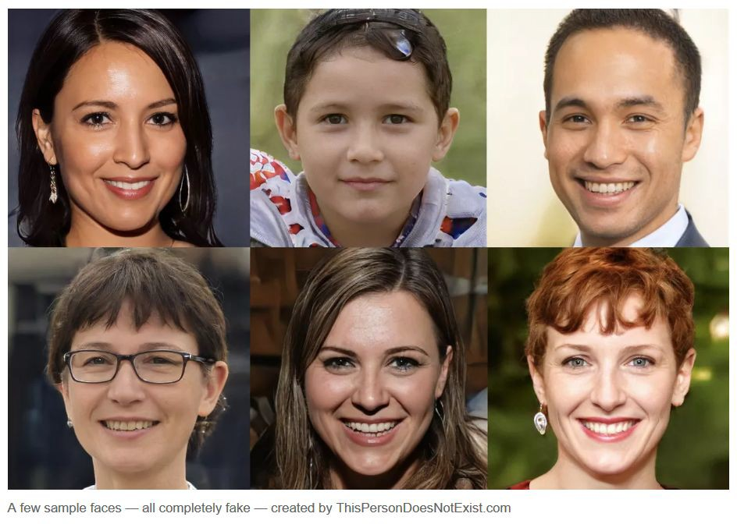
Deep learning face generation

Slide 10
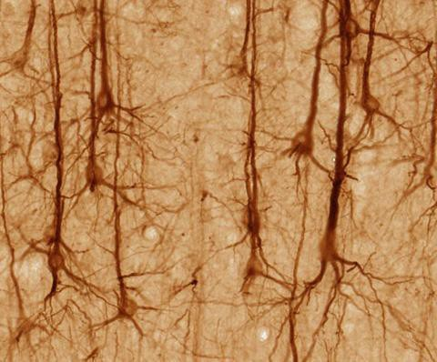
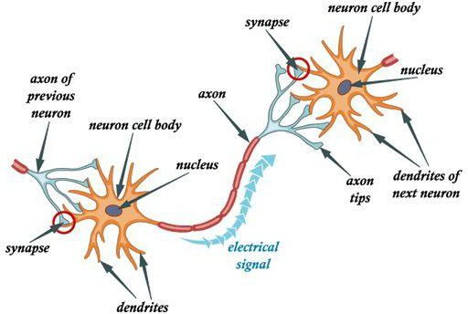
Neurons in Biological Systems

Slide 11
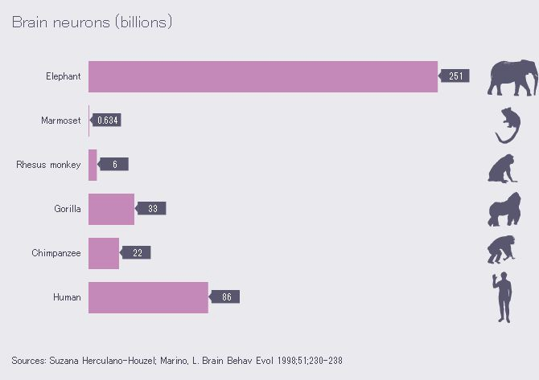
Neurons in Biological Systems

Slide 12
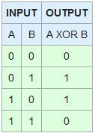
Perceptron
What’s special about XOR operation?
How do we handle linearly inseparable cases?

Slide 13
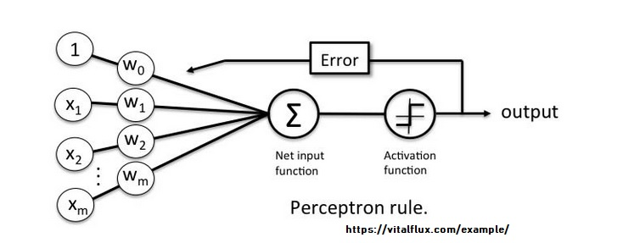
Perceptron Inputs and Outputs

Slide 14
Perceptron vs Linear Regression
Linear Regression
Y = WX + b
Perceptron
Y = Activation function (WX + b)

Slide 15
Example 1: A Simple Dataset
Label | Cholesterol | Weight | Height
Risk | 251 | 267 | 70
NoRisk | 105 | 103 | 62
Risk | 156 | 193 | 72
NoRisk | 109 | 100 | 63
Risk | 198 | 210 | 70
Risk | 189 | 189 | 64
NoRisk | 121 | 105 | 65
NoRisk | 134 | 125 | 60
Risk | 250 | 156 | 69
NoRisk | 118 | 190 | 71
Risk | 290 | 300 | 62
Dataset Link: https://drive.google.com/file/d/1Ydi5zIyZUbYvCJjfpL2S-EbS9AeWAjOH/view?usp=sharing
Sample of the larger dataset
Can we train and test a perceptron using this data?

Slide 16
Python Libraries
from sklearn import datasets
from sklearn.preprocessing import StandardScaler
from sklearn.linear_model import Perceptron
from sklearn.model_selection import train_test_split
from sklearn.metrics import accuracy_score
import numpy as np
import pandas as pd
from sklearn.preprocessing import LabelEncoder

Slide 17
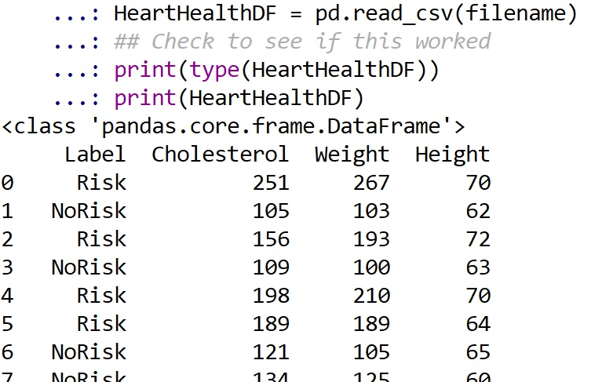
Step 1: Read in the Data

Slide 18
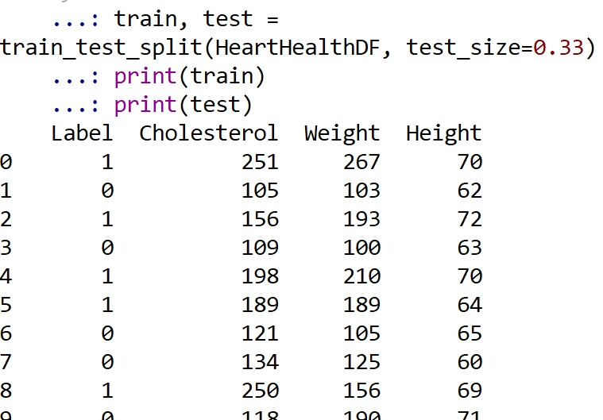
Change Label to Binary
from sklearn.preprocessing import LabelEncoder
le = LabelEncoder()
HeartHealthDF['Label'] = le.fit_transform(HeartHealthDF['Label’])
print(HeartHealthDF)
## Split DF into training and testing
train, test = train_test_split(HeartHealthDF, test_size=0.33)
print(train)
print(test)

Slide 19
Remove Labels
Test Label
31 0
14 1
18 0
23 1
9 0
22 0
30 0
26 1
21 1
## Take off the label and make it numeric
## for training and testing datasets
TrainLabel=train["Label"]
print(TrainLabel)
TestLabel=test["Label"]
print(TestLabel)
## Drop label from datasets
train = train.drop('Label', axis=1)
test= test.drop('Label', axis=1)
Test Data
Cholesterol Weight Height
31 129 160 72
14 175 145 63
18 124 125 70
23 278 300 68
9 118 190 71
22 128 140 61
30 135 105 64

Slide 20
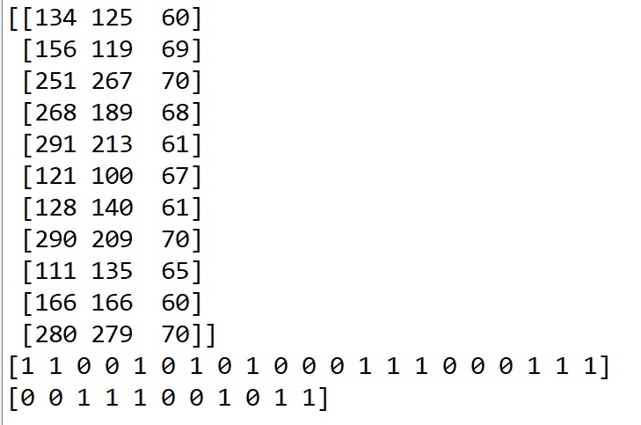
Format Matters
## The fit method requires a numpy array.
## Let's convert
train=train.to_numpy()
test=test.to_numpy()
TrainLabel=TrainLabel.to_numpy()
print(TrainLabel)
TestLabel=TestLabel.to_numpy()
print(TestLabel)

Slide 21
Perceptron in sklearn
## Instantiate Perceptron in sklearn
## https://scikit-learn.org/stable/modules/generated/sklearn.linear_model.Perceptron.html
MyPerceptron = Perceptron(max_iter=1000)
## fit method requires an array or sparse matrix
## Run (fit the data to) the perceptron
MyPerceptron.fit(train, TrainLabel)
## Test the perceptron
print("\n\nThe predicted labels are:")
print(MyPerceptron.predict(test))
## Print the actual known test labels
print("\nThe true test labels are:")
print(TestLabel)
The predicted labels are:
[1 0 1 1 0 0 1 0 0 1 1]
The true test labels are:
[1 0 1 1 0 0 1 0 0 1 1]

Slide 22
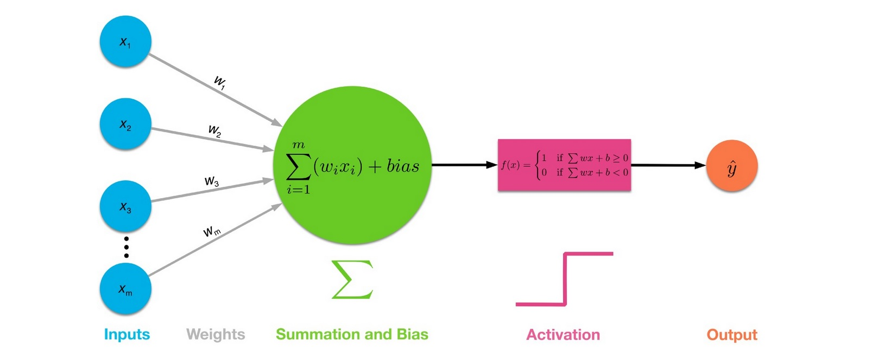
X1 is 251
X2 is 267
X3 is 70
Y = 1
If sum >= 0 → 1
Else if sum < 0 → 0
Label | Chol | Weight | Height
1 | 251 | 267 | 70
0 | 105 | 103 | 62
1 | 156 | 193 | 72
0 | 109 | 100 | 63
1 | 198 | 210 | 70
b = -500 and w1, w2, w3 are all 1
w1x1 + w2x2 + w3x3 -500
251 + 267 + 70 -500 = 88 → 1
105 + 103 + 62 – 500 = -230 →0

Slide 23
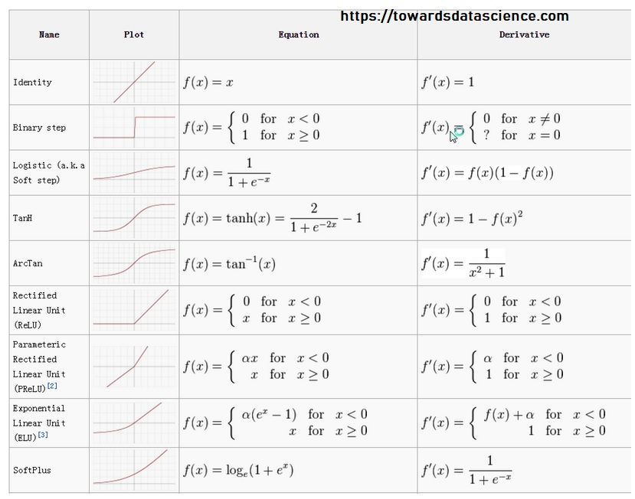
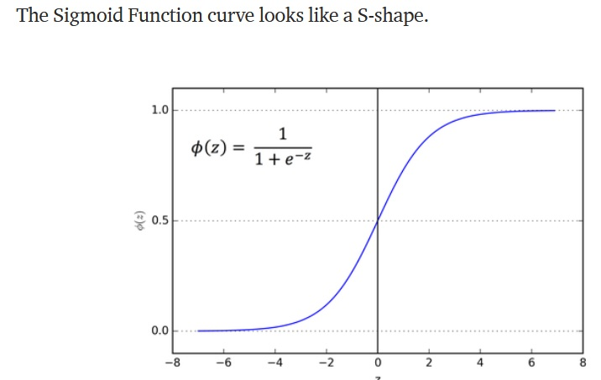
Activation Functions
1) Step
2) Sign
3) Sigmoid
4) Gaussian
5) Tanh
6) Softmax
7) ReLU
https://towardsdatascience.com/activation-functions-neural-networks-1cbd9f8d91d6

Slide 24
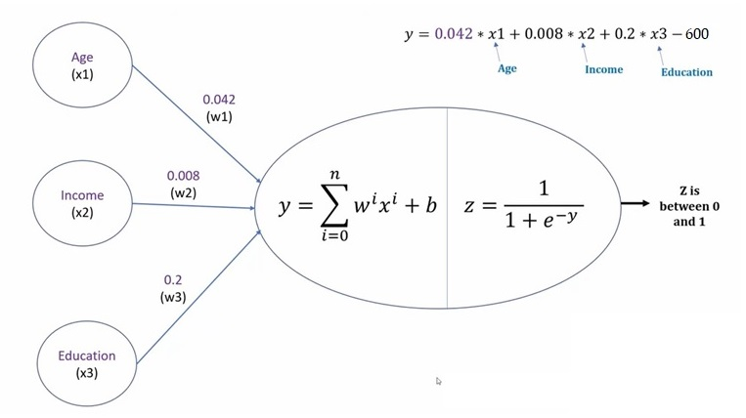
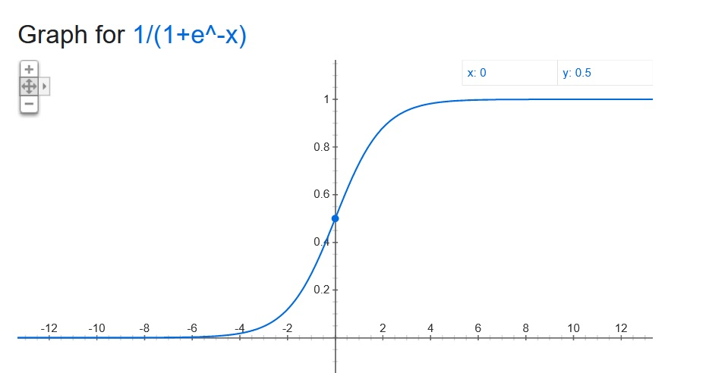
Loan or No Loan? (sigmoid activation function)
Example: Age 21, Income 40K, Education 4
Y = .042(21) + .008(40000) + .2(4) – 600 =-278
Z = 1 / (1 + e^-(-278)) = 0
Result/Output is 0 -no loan
Example: Age 51, Income 140K, Education 4
Y = .042(28) + .008(80000) + .2(4) – 600 =42
Z = 1 / (1 + e^-42) = 1
Result/Output is 1 – yes loan

Slide 25
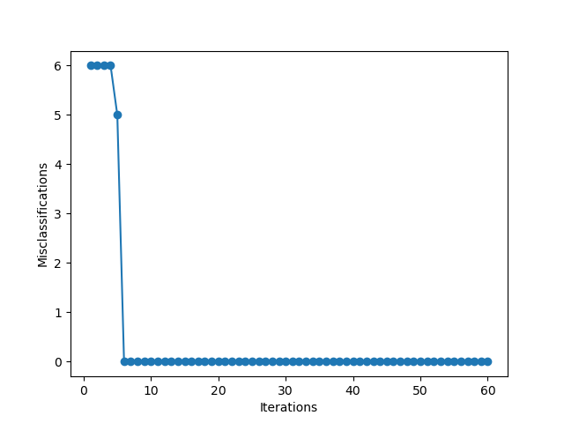
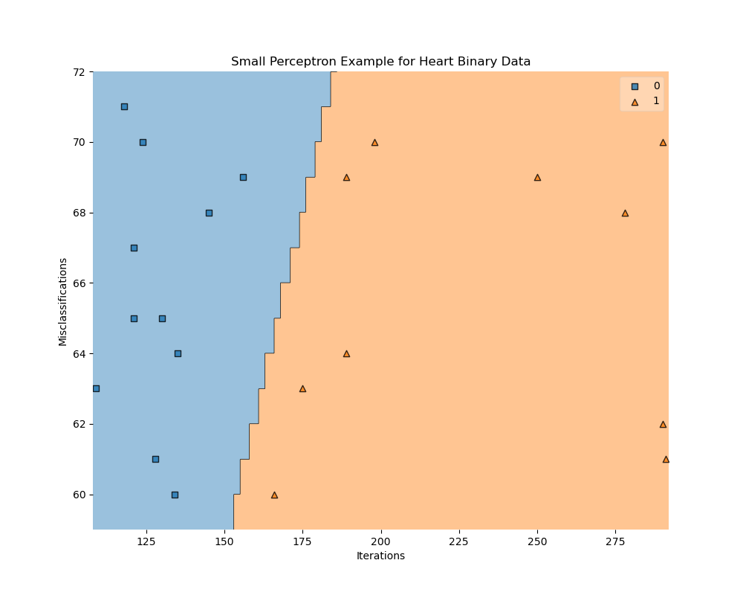
Perceptrons by hand - Python Using a Class
Review this code – the dataset link is in the code
https://docs.google.com/document/d/1m8I2QViqA6bV7HoFWZpYHK7UEitapSmC5ld8LM5FHEo/edit?usp=sharing

Slide 26
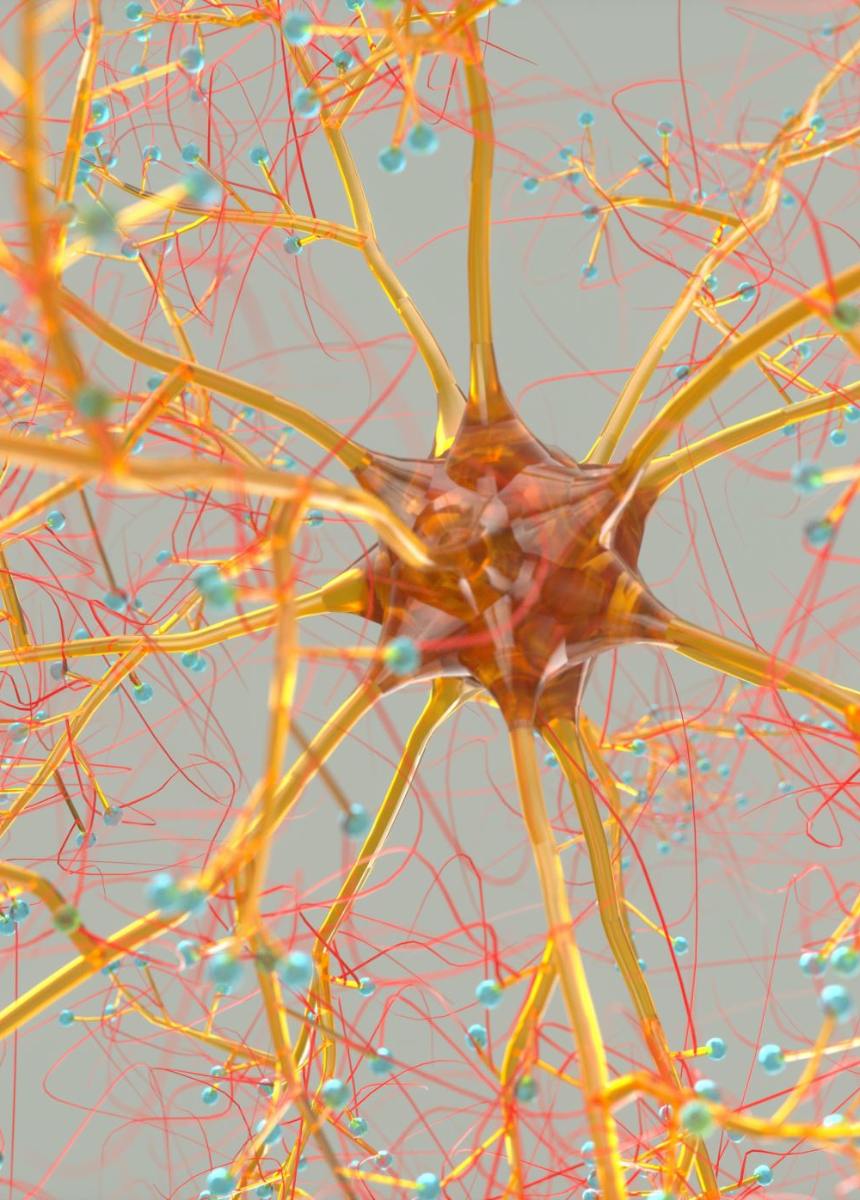
Neural Networks
There are three core types of NNs:
1) ANN – Artificial NN (feed forward)
2) CNN – Convolutional NNs (3D neuron arrangement)
3) RNN – Recurrent NN – output is fed back

Slide 27
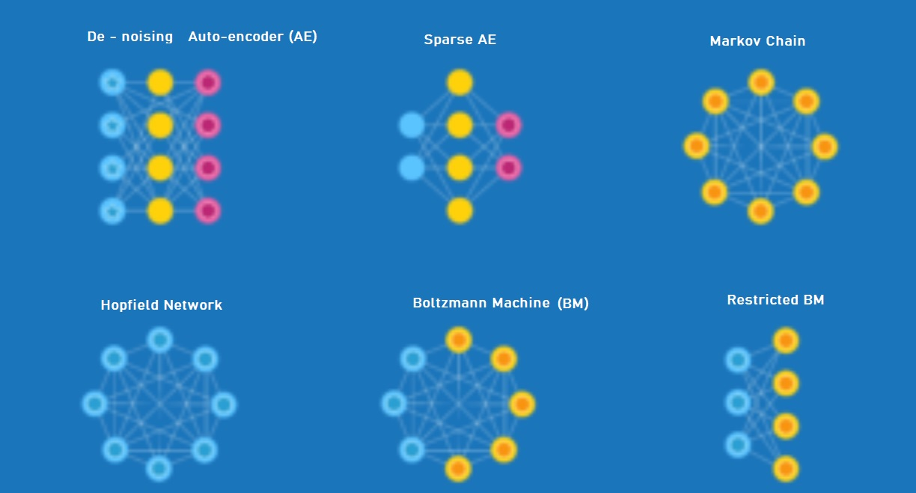
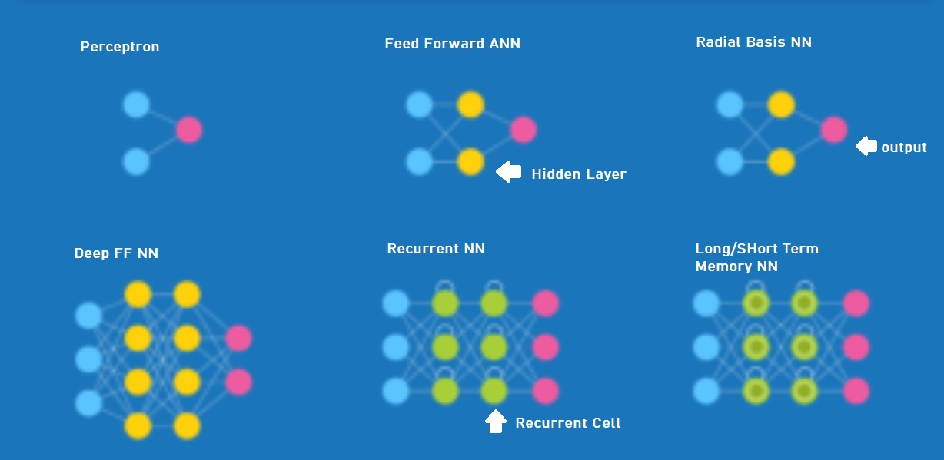
Network Architecture

Slide 28
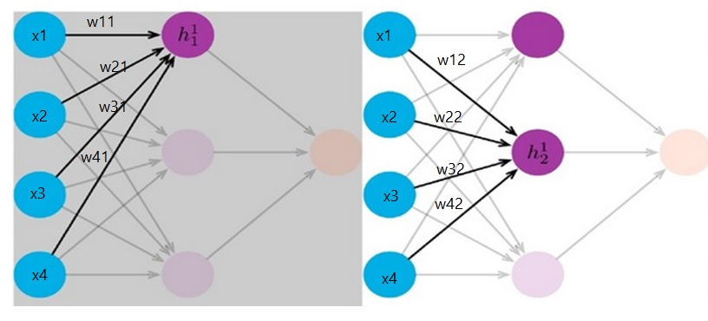
h11 = w11x1 + w21x2 + w31x3 + w41x4 + b The output of h1 will depend on the Activation Function h12 = w12x1 + w22x2 + w32x3 + w42x4 + b The output of h2 will depend on the Activation Function

Slide 29
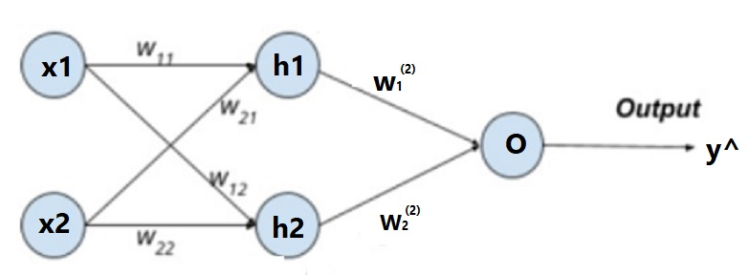
network example & basic forward equations
h1 = S(z11), where S is the sigmoid activation function
h2 = S(z12)
z2 = w1h1 + w2h2 + c
y^ = S(z2)
z11 = w11x1 + w21x2 + b1
z12 = w12x1 + w22x2 + b2

Slide 30
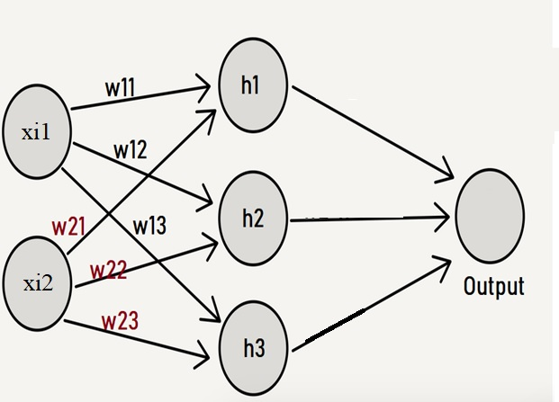
The W1 matrix must be 2 by 3, where 2 is the number of x inputs or features (columns) and 3 is the number of hidden units in H1.
w11 w12 w13
w21 w22 w23
To matrix multiply (@) the W1 and the X, we need this format:
X @ W1
(n by c) @ (c by h)
(n by 2) @ (2 by 3) → n by 3 matrix
Our biases for the inputs, b1, b2, …, bh must be of shape
x11 x12
x21 x22 @
x31 x32
…
w11 w12 w13
w21 w22 w23
+
b1 b2 b3
x11w11+x12w21+b1 x11w12+x12w22+b2 x11w13+x12w23+b3
x21w11+x22w21+b1 x21w12+x22w22+b2 x21w13+x22w23+b3
x31w11+x32w21+b1 x31w12+x32w22+b2 x31w13+x32w23+b3
…

Slide 31
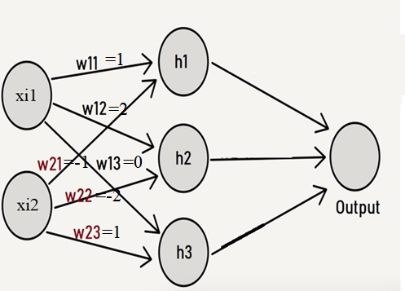
x11 x12
x21 x22 @
x31 x32
x41 x42
w11 w12 w13
w21 w22 w23
+
b1 b2 b3
3 4
6 -2 @
2
-2 5
…
1 2 0
-1 -2 1
+
8 9 11
(3)(1) + (4)(-1) + 8 (3)(2) + (4)(-2) + 9 (3)(0) + (4)(1) + 11
(6)(1) + (-2)(-1) + 8 (6)(2) + (-2)(-2) + 9 (6)(0) + (-2)(1) + 11
(1)(1) + (2)(-1) + 8 (1)(2) + (2)(-2) + 9 (1)(0) + (2)(1) + 11
(-2)(1) + (5)(-1) + 8 (-2)(2) + (5)(-2) + 9 (-2)(0) + (5)(1) + 11
3 4
6 -2
2
-2 5
…
x11w11+x12w21+b1 x11w12+x12w22+b2 x11w13+x12w23+b3
x21w11+x22w21+b1 x21w12+x22w22+b2 x21w13+x22w23+b3
x31w11+x32w21+b1 x31w12+x32w22+b2 x31w13+x32w23+b3
x41w11+x42w21+b1 x41w12+x42w22+b2 x41w13+x42w23+b3

Slide 32
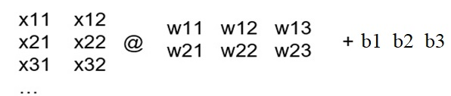
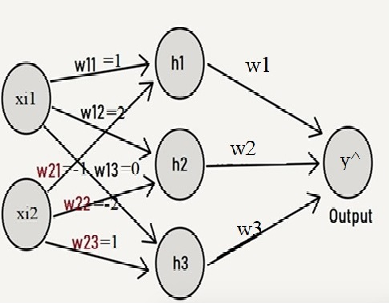
The Z and A
zi1 zi2 zi3
x11w11+x12w21+b1 x11w12+x12w22+b2 x11w13+x12w23+b3
x21w11+x22w21+b1 x21w12+x22w22+b2 x21w13+x22w23+b3
x31w11+x32w21+b1 x31w12+x32w22+b2 x31w13+x32w23+b3
x41w11+x42w21+b1 x41w12+x42w22+b2 x41w13+x42w23+b3
W2 = [w1
w2
w3]
= 1
The above matrix is Z1 which is n by h
Next, we ACTIVATE each element to create A(Z1)
h11 = A(z11) h12 = A(z12) h13 = A(z13)
Next, we need:
Z2 = A(Z1) @ W2
n by h @ h by 1 → n by 1
y^ = A(Z2) shape n by 1
= -2
= 0
CODE: https://drive.google.com/file/d/1__A7-BgR5HA550QLK3EXSAP0UpHlshBm/view?usp=sharing

Slide 33
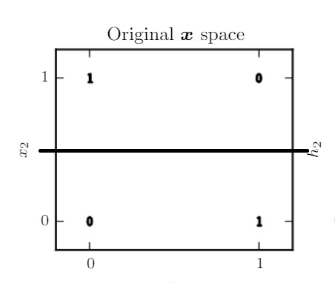
Can Linear Regression Predict XOR?
[ 0 0 ] → 0 ?
[ 0 1 ] → 1 ?
[ 1 0 ] → 1 ?
[ 1 1 ] → 0 ?

Slide 34
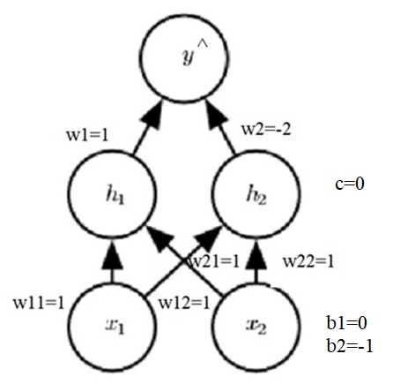
XOR
import numpy as np
X = np.array([[0,0], [0, 1],[1,0], [1,1]]) ## 4 by 2
## Inputs are n rows by c features/columns
print(X)
print(X.shape)
Y = np.array([[0],[1],[1],[0]])
numOutputs = 1
NumHidden = 2
##-------- INPUT LAYES X --> H
W1=np.array([[1,1], [1,1]]) ## shape is c by h
print(W1.shape)
bs=np.array([[0, -1]]) ## shape 1 by h
print(bs.shape)
Z1 = (X@W1) + bs ## n by c @ c by h -> n by h
print(Z1.shape)
A_Z1 = np.maximum(0,Z1) ## n by h
print(A_Z1.shape)
##-----------------HIDDEN to OUTPUT
W2= np.array([[1],[-2]]) # shape h by 1
print(W2.shape)
c= 0
Z2 = A_Z1@W2 + c ## shape n by h @ h by 1 y_hat=np.maximum(0, Z2) ## shape n by 1
print(y_hat)

Slide 35
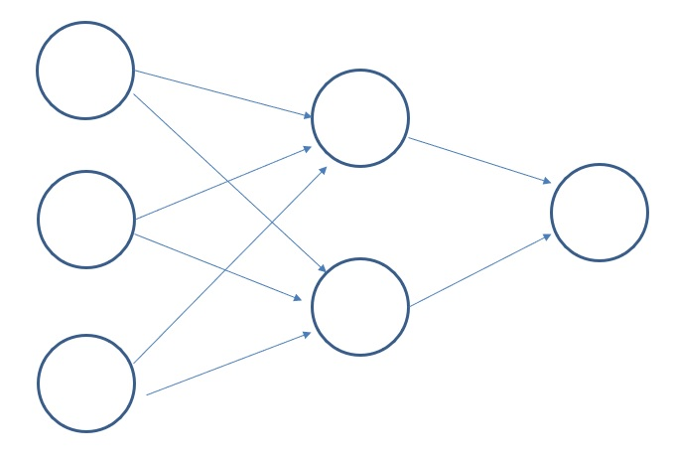
In-Class Activity – Submit to Canvas
Fill out/label the network
Create – by hand- all FF steps of this NN by with matrices and matrix multiplication (@).
Code the FF network into Python
Use the Sigmoid activation function throughout.
SUBMIT to Canvas the PYTHON code only and INCLUDE comments and shapes as well as output.
Use the following NOTATION and have results for the following:
z11=
z12=
h1= A(z11) =
h2=A(z12) =
z2=
y^= A(z2) =
Note that:
X is the input dataset with 3 columns and n rows.
Use n = 5 for this exercise.
Z1 is the matrix of zi1, zi2
etc.

Slide 36
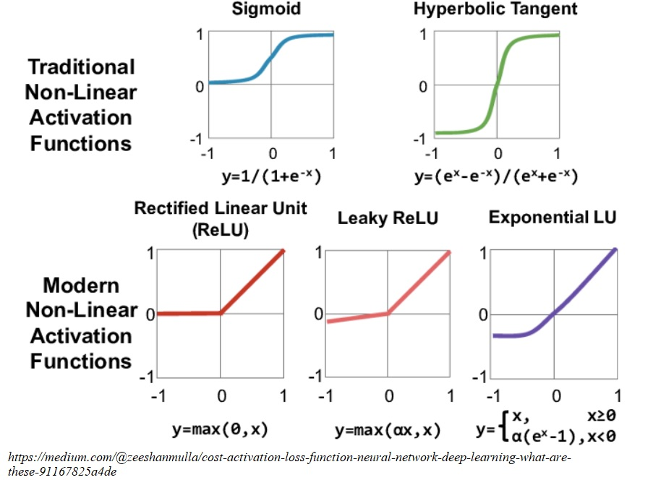
Activation Functions

